Slide 1
Querying, Tuning, Troubleshooting

Slide 2
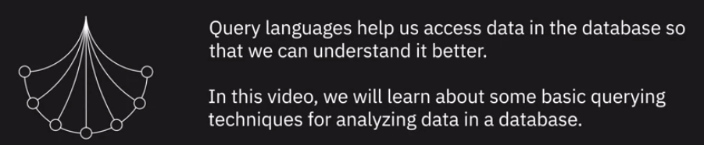
7.Querying and Analyzing Data

Slide 3
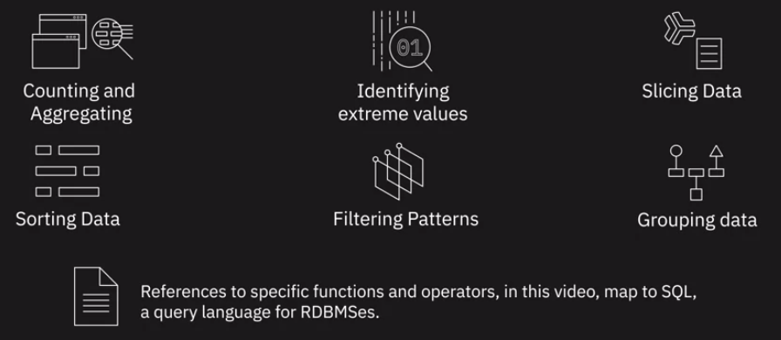


7.Querying and Analyzing Data
such as Cassandra CQL and Cypher for Neo4J

Slide 4
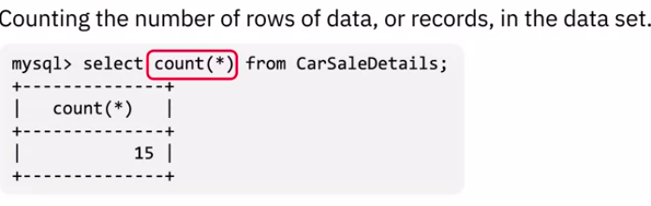
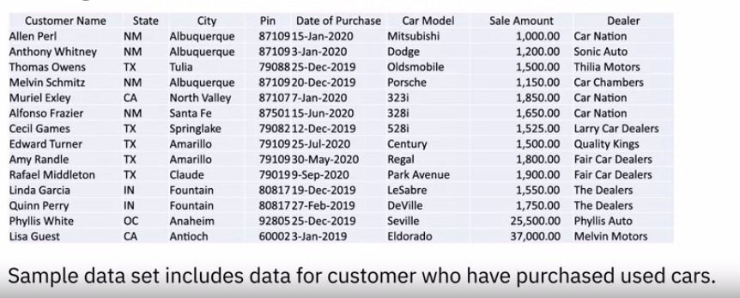
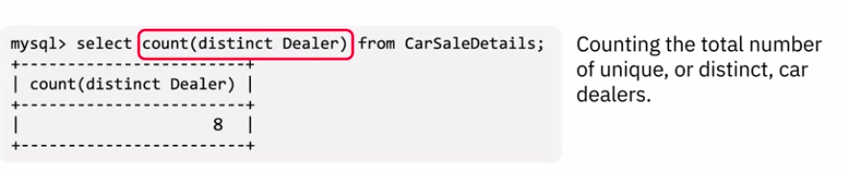
7.Querying and Analyzing Data - Counting

Slide 5
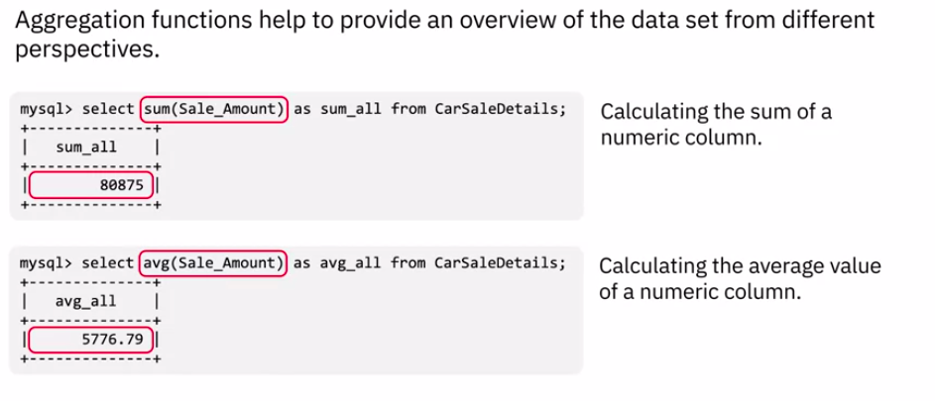
7.Querying and Analyzing Data - Aggregation

Slide 6
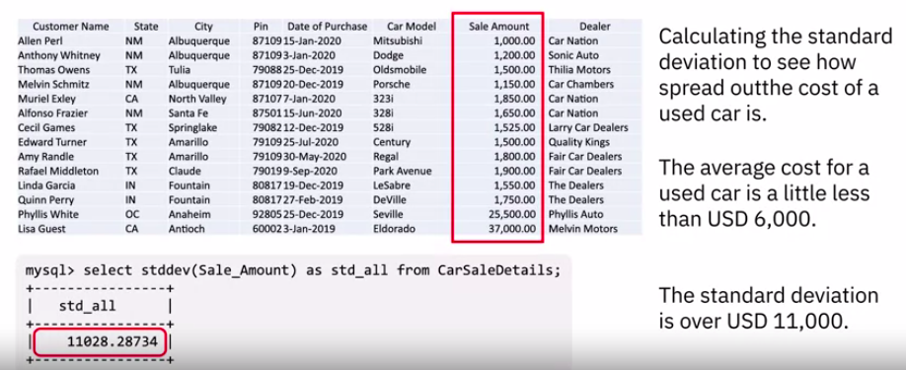
7.Querying and Analyzing Data - Aggregation

Slide 7
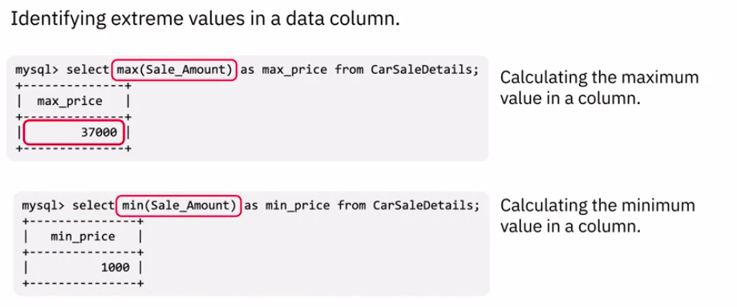
7.Querying and Analyzing Data - Extreme values

Slide 8
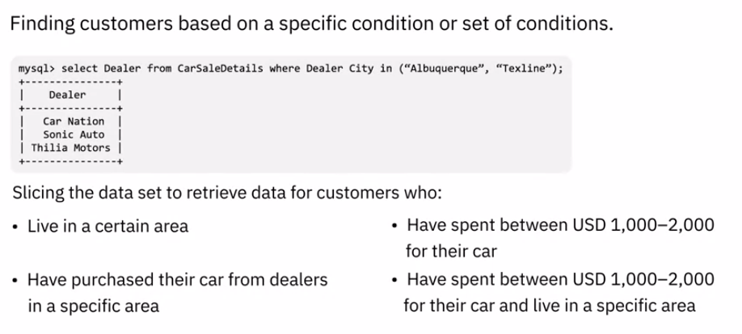
7.Querying and Analyzing Data - Slicing data

Slide 9
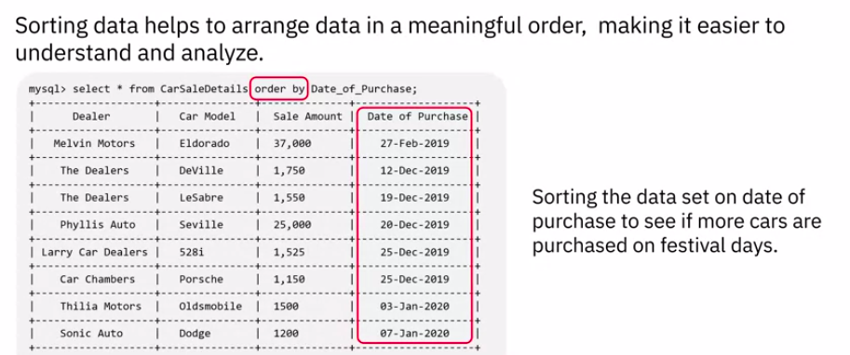
7.Querying and Analyzing Data - Sorting

Slide 10
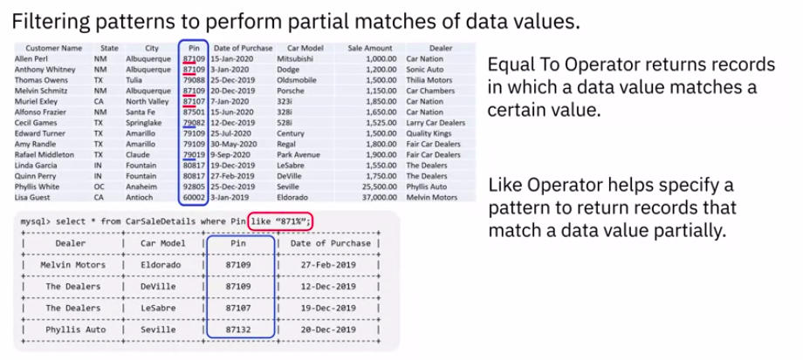
7.Querying and Analyzing Data - Filtering

Slide 11
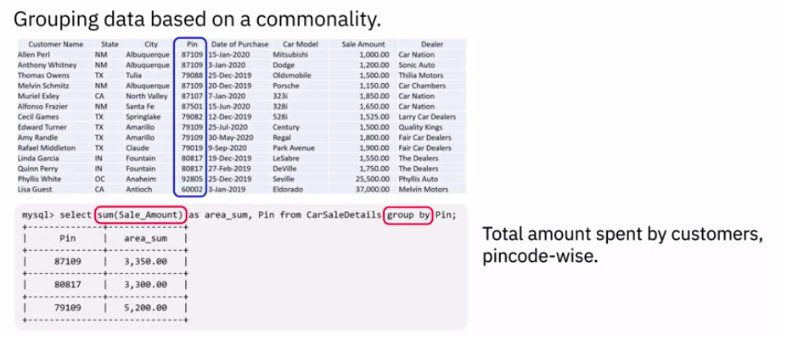
7.Querying and Analyzing Data - Grouping

Slide 12
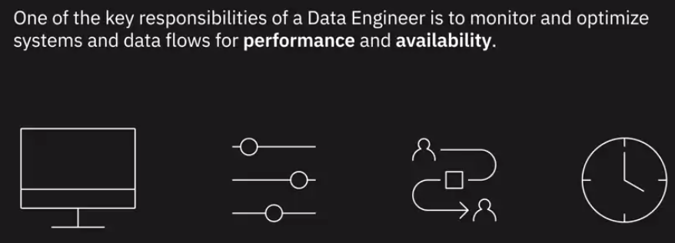
8. Performance Tuning and Troubleshooting

Slide 13
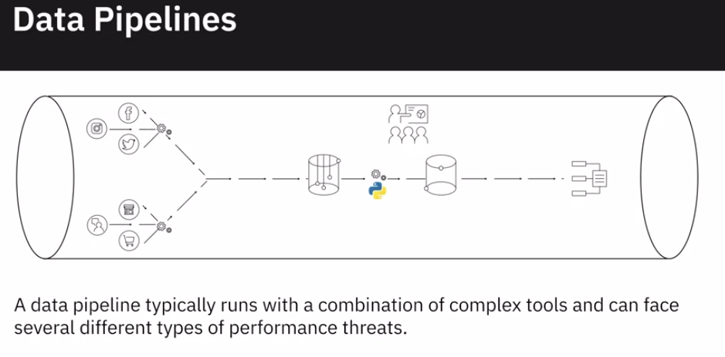
8. Performance Tuning and Troubleshooting

Slide 14
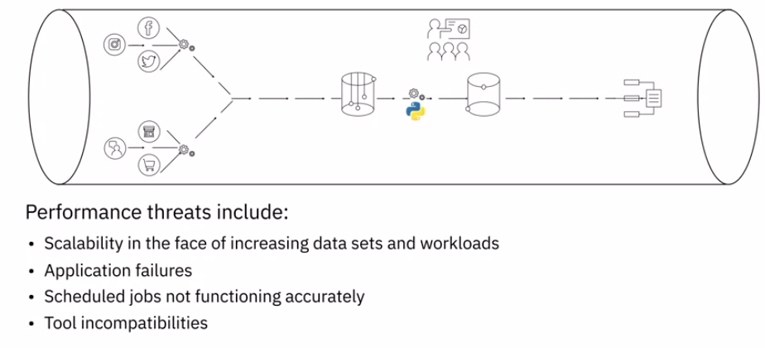
8. Performance Tuning and Troubleshooting
Application failures Scheduled jobs not starting as per schedule, waiting on dependencies, or some of the tasks not running in the correct sequence or not running at all and Tool incompatibilities, since data pipelines consist of a variety of tools handling different tasks

Slide 15
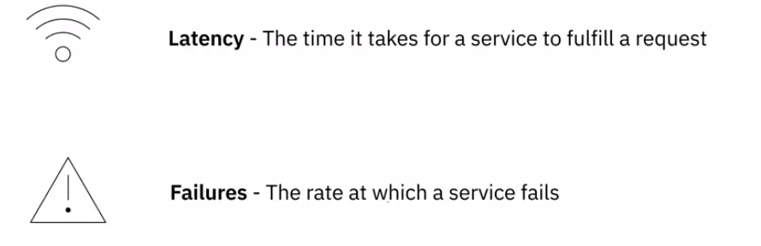
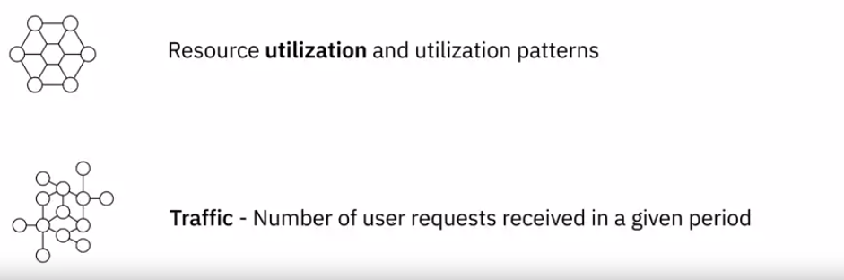
8. Performance metrics in Data Pipeline

Slide 16
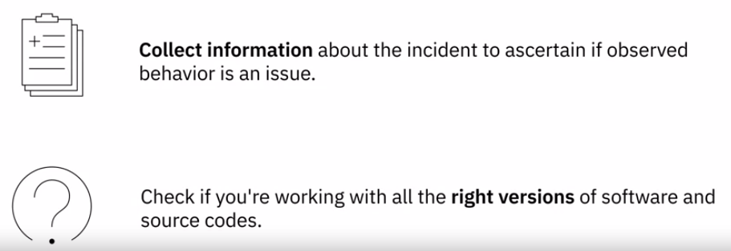
8. Troubleshooting in Data Pipeline
It depends on the issue, but generically speaking, these are some of the steps you will probably take.
The first step would be to collect as much information about the incident as possible, most importantly, to ascertain if the observed behavior is actually an issue. The issue could have been reported through an alerting system, by a user, or flagged during a maintenance check.

Slide 17
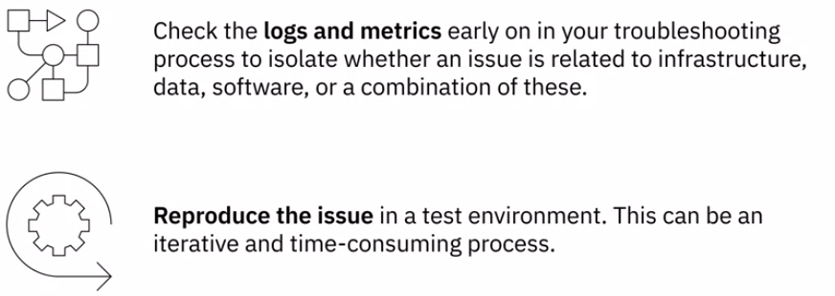
8. Troubleshooting in Data Pipeline

Slide 18
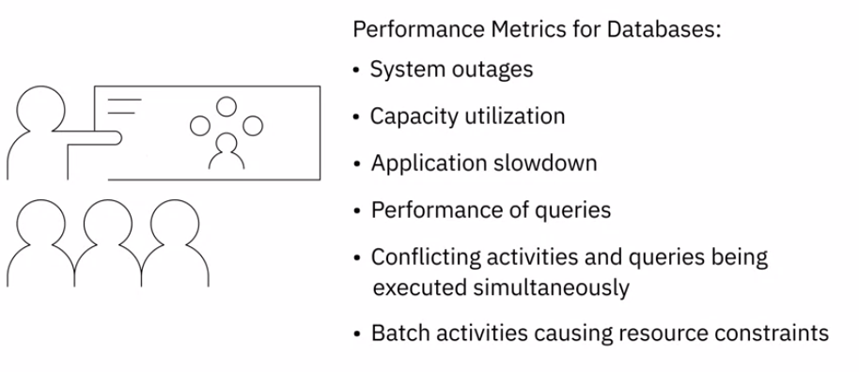
8. Databases Optimization for Performance [KPI’s]

Slide 19
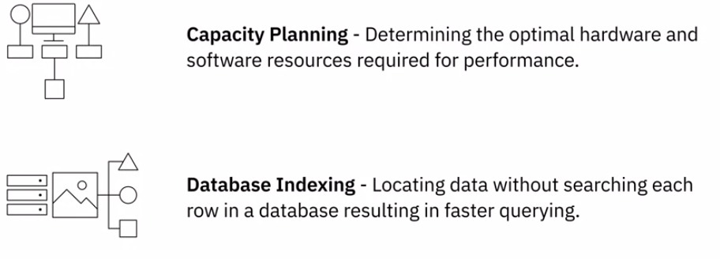
8. Databases Optimization for Performance

Slide 20
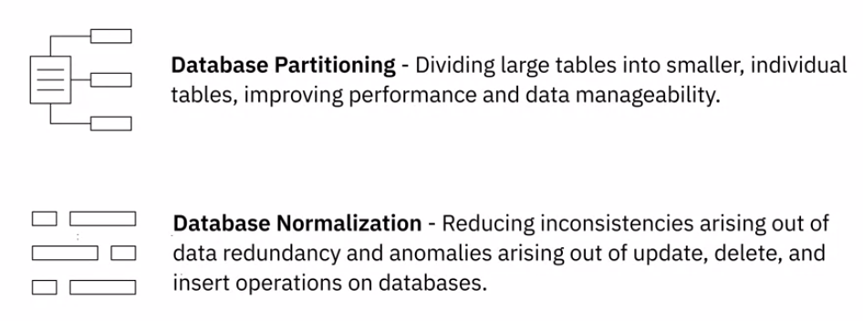
8. Databases Optimization for Performance

Slide 21
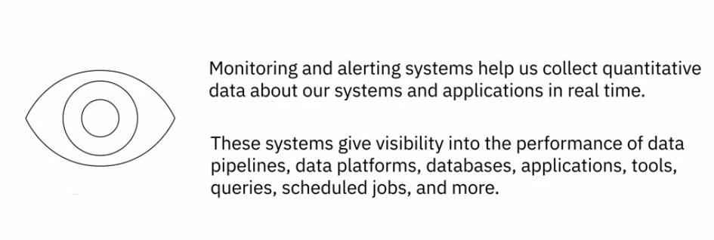
8.Monitoring System

Slide 22
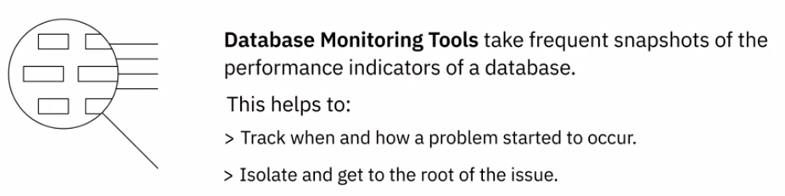
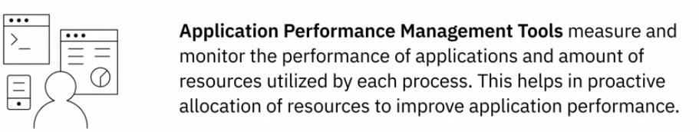
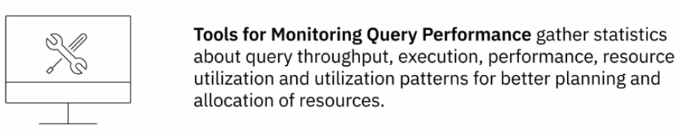
8.Monitoring System

Slide 23

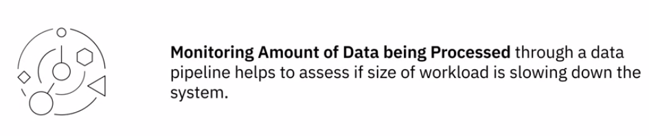
8.Monitoring System

Slide 24
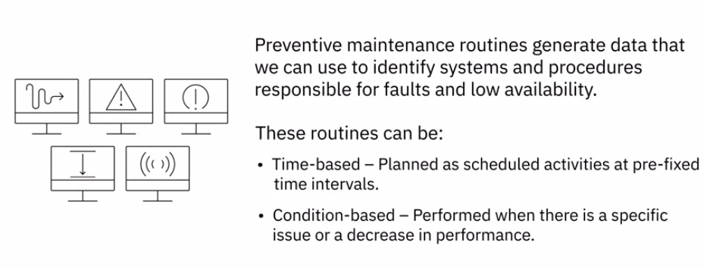
8. Maintenance Schedule

Slide 25
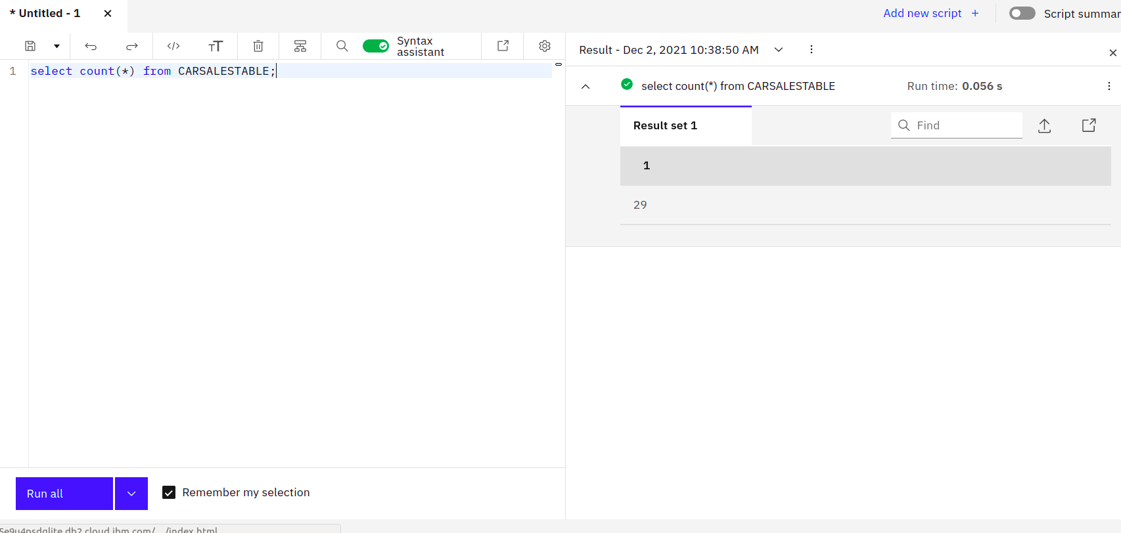
9. Query Lab

Slide 26
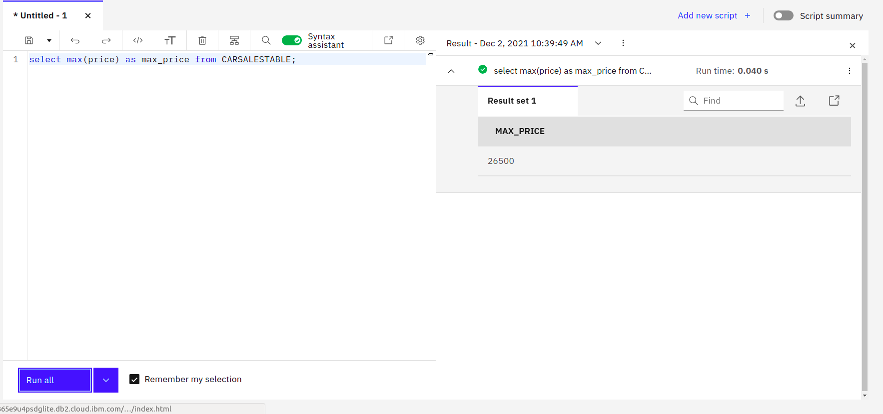
9. Query Lab

Slide 27
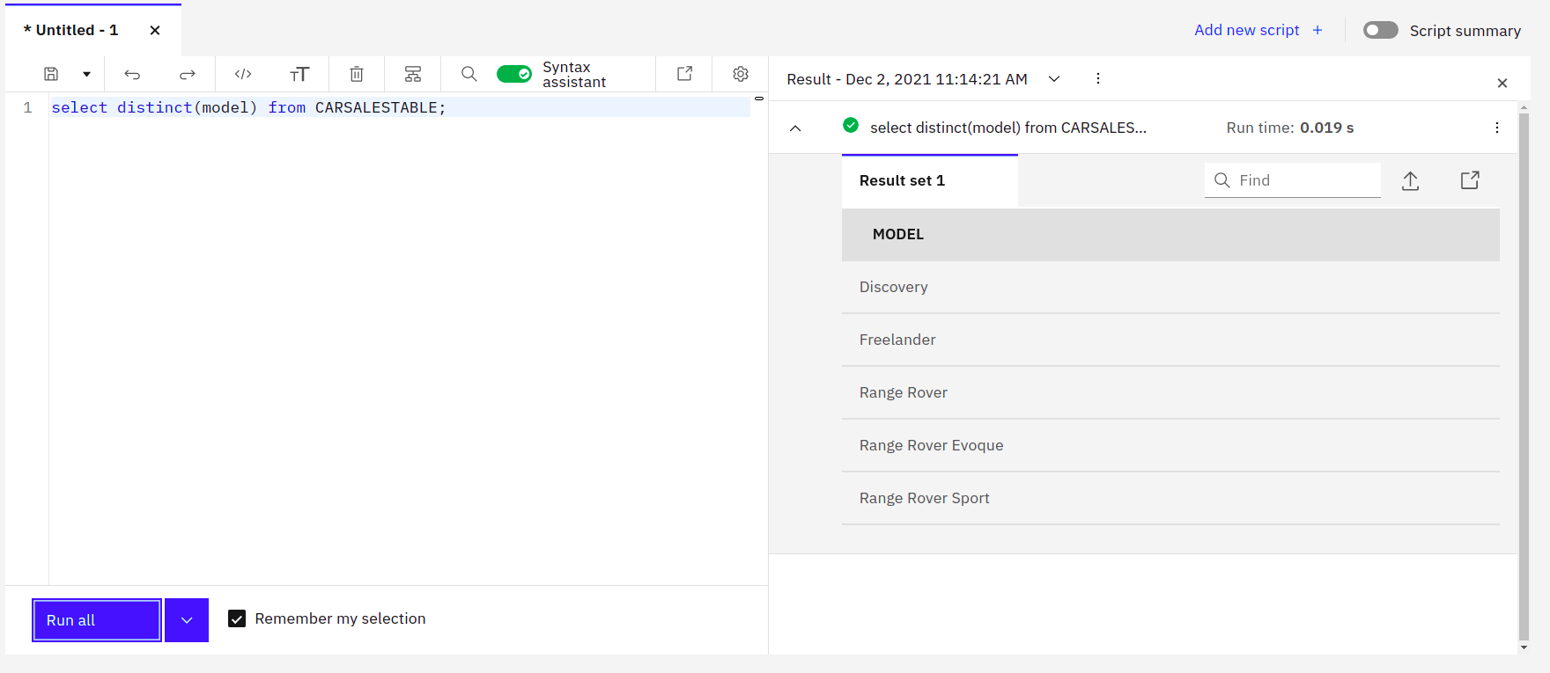
9. Query Lab

Slide 28
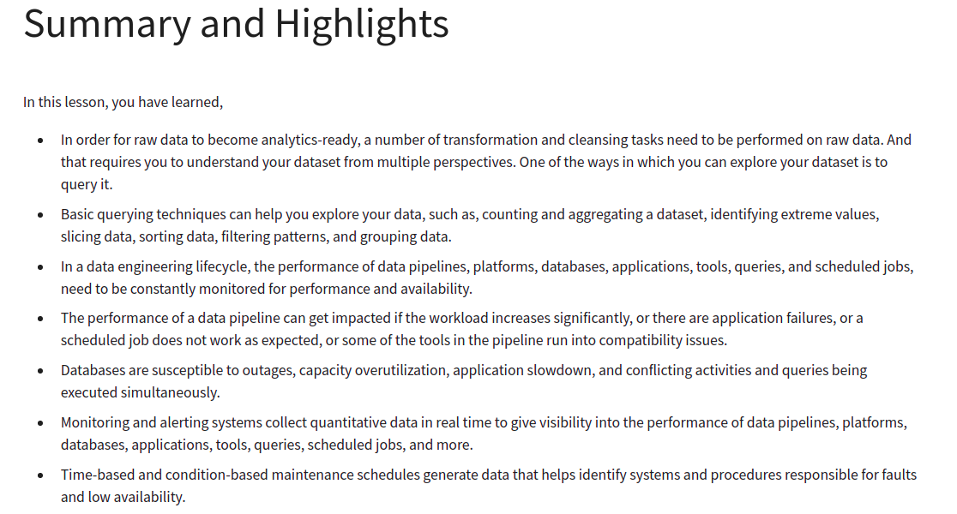
Recap

Slide 29
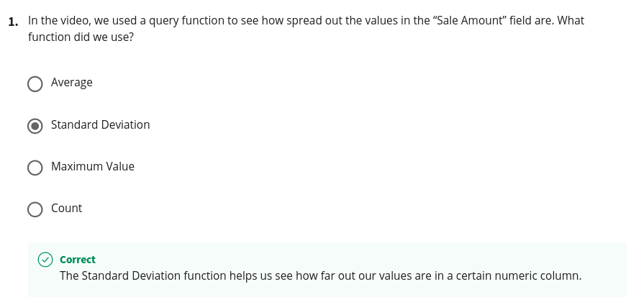
Quiz

Slide 30
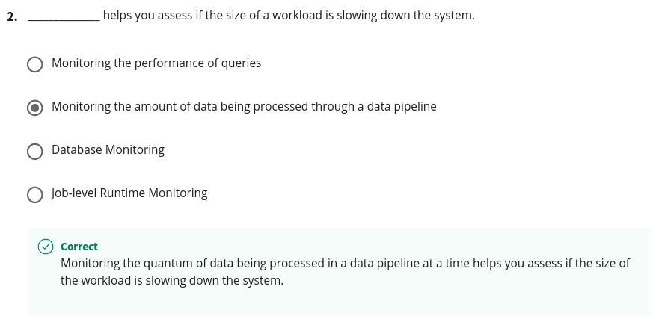
Quiz

Slide 31
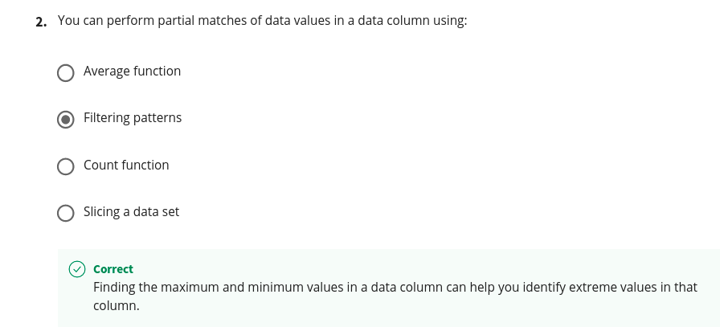
Quiz

Slide 32
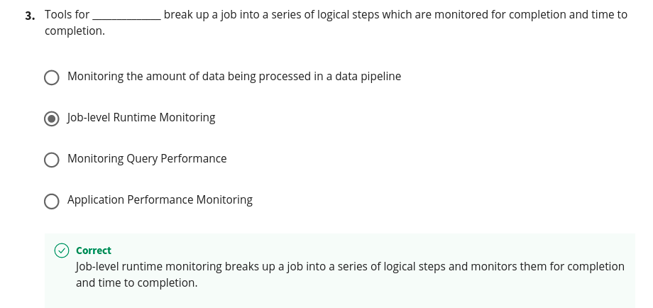
Quiz

Slide 33
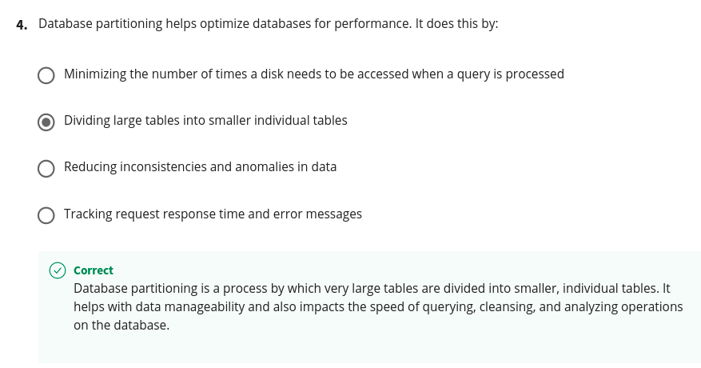
Quiz

Slide 34
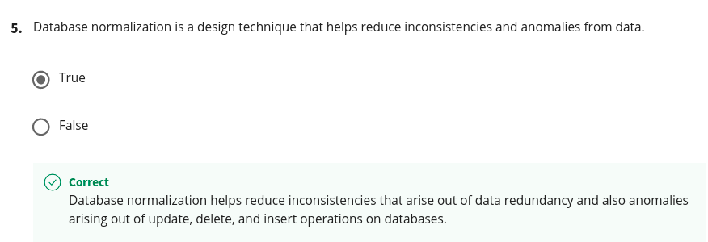
Quiz

Slide 35
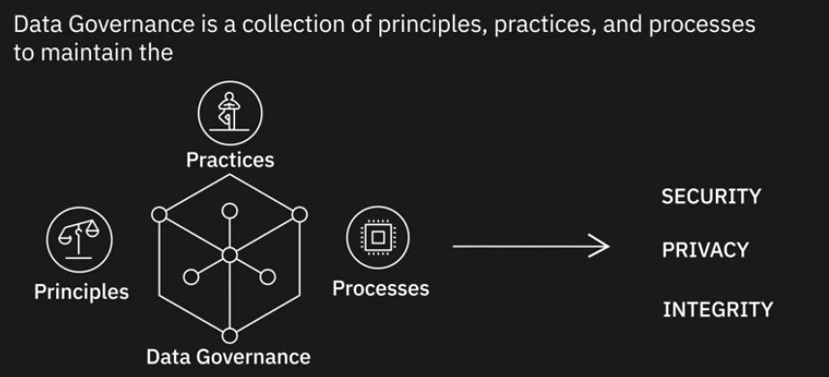
10. Governance and Compliance
A data governance framework encompasses every part of an organization's data management process—including the technologies, databases, and data models.

Slide 36
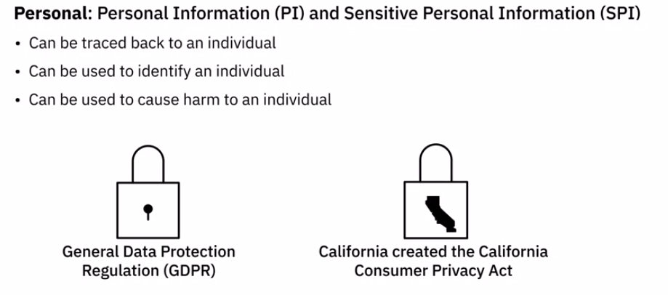
10. Data that need Governance - Personal Information

Slide 37
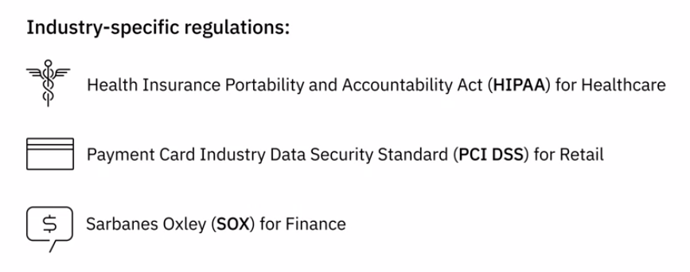
10. Data that need Governance - Industry-specific regulation

Slide 38
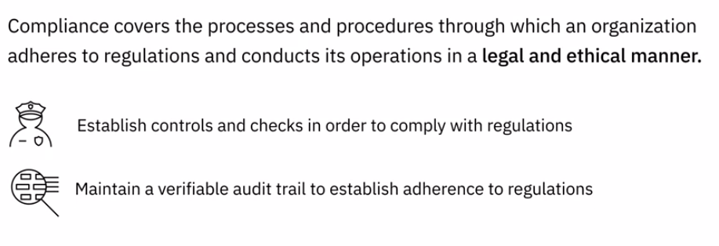
10. Compliance
Consequences of non-compliance with the standards can be severe. They can result in financial penalties, mar public perception, and result in loss of trust amongst clients and partners

Slide 39
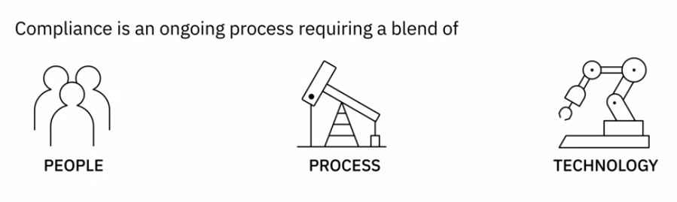
10. Compliance

Slide 40
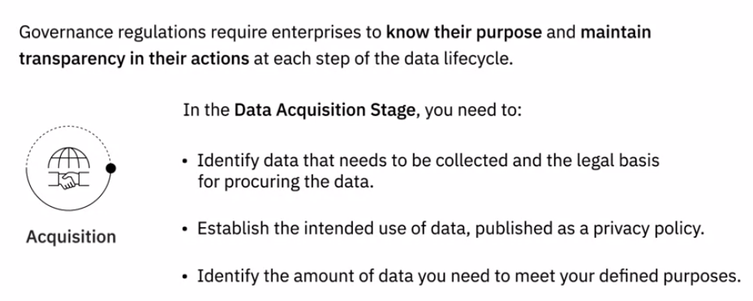
10. Data lifecycle - Data Acquisition Stage

Slide 41
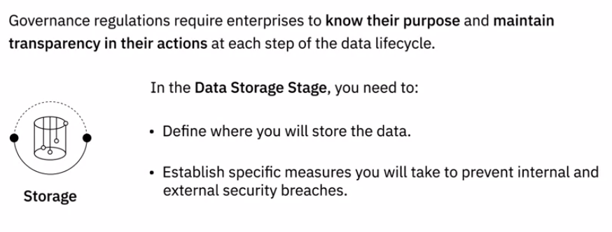
10. Data lifecycle - Data Storage Stage

Slide 42
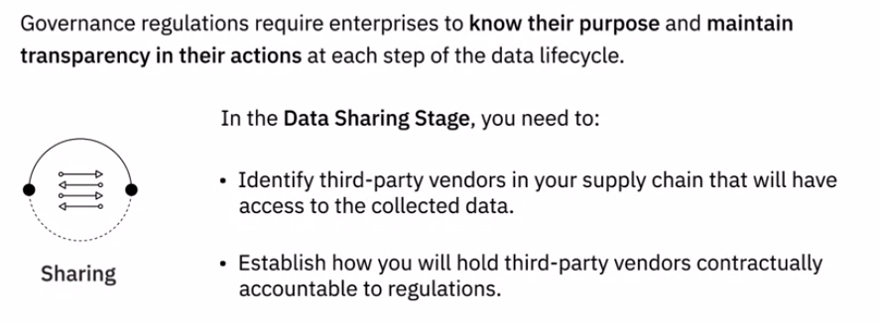
10. Data lifecycle - Data Sharing Stage

Slide 43
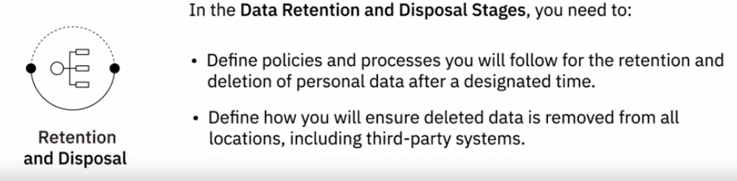
10. Data lifecycle - Data Retention and Disposal Stage

Slide 44
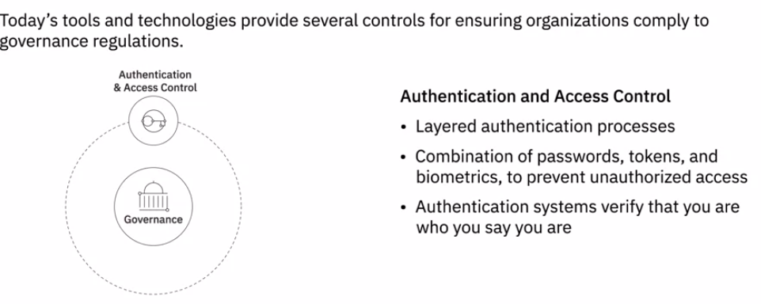
10. Technology as Enabler

Slide 45
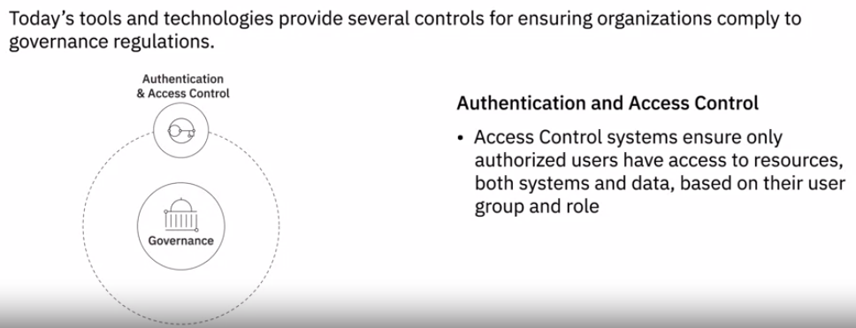
10. Technology as Enabler

Slide 46
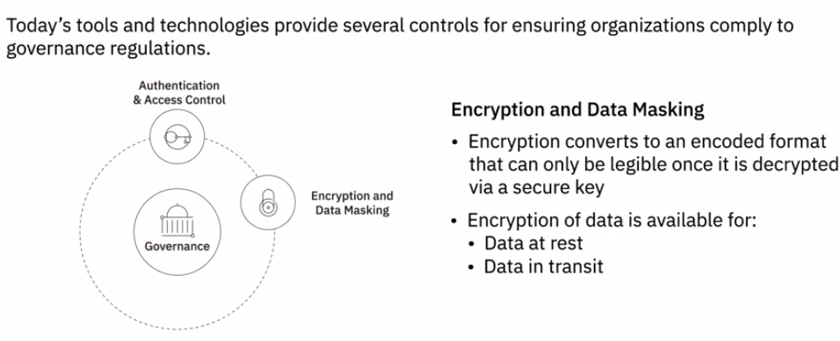

10. Technology as Enabler

Slide 47

10. Technology as Enabler

Slide 48


10. Technology as Enabler

Slide 49

10. Technology as Enabler

Slide 50

Recap

Slide 51
Optional: Overview of the DataOps Methodology
Gartner defines DataOps as a collaborative data management practice focused on improving the communication, integration, and automation of data flows between data managers and consumers across an organization. DataOps aims to create predictable delivery and change management of data, data models, and related artifacts. DataOps uses technology to automate data delivery with the appropriate levels of security, quality, and metadata to improve the use and value of data in a dynamic environment.”
(Source: https://blogs.gartner.com/nick-heudecker/hyping-dataops/) A small team working on a simpler or limited number of use cases can meet business requirements efficiently. As data pipelines and data infrastructures get more complex, and data teams and consumers grow in size, you need development processes and efficient collaboration between teams to govern the data and analytics lifecycle. From data ingestion and data processing to analytics and reporting, you need to reduce data defects, ensure shorter cycle times, and ensure 360-degree access to quality data for all stakeholders.
DataOps helps you achieve this through metadata management, workflow and test automation, code repositories, collaboration tools, and orchestration to help manage complex tasks and workflows. Using the DataOps methodology ensures all activities occur in the right order the right security permissions. It helps set in a continual process that allows you to cut wastages, streamline steps, automate processes, increase throughput, and improve continually.
Several DataOps Platforms are available in the market, some of the popular ones being IBM DataOps, Nexla, Switchboard, Streamsets, and Infoworks.

Slide 52
Optional: Overview of the DataOps Methodology
DataOps Methodology:
The purpose of the DataOps Methodology is to enable an organization to utilize a repeatable process to build and deploy analytics and data pipelines. Successful implementation of this methodology allows an organization to know, trust, and use data to drive value.
It ensures that the data used in problem-solving and decision making is relevant, reliable, and traceable and improves the probability of achieving desired business outcomes. And it does so by tackling the challenges associated with inefficiencies in accessing, preparing, integrating, and making data available.
In a nutshell, the DataOps Methodology consists of three main phases:
The Establish DataOps Phase provides guidance on how to set up the organization for success in managing data.
The Iterate DataOps Phase delivers the data for one defined sprint.
The Improve DataOps Phase ensures learnings from each sprint is channeled back to continually improve the DataOps process.

Slide 53

Optional: Overview of the DataOps Methodology
The figure below presents a high-level overview of these phases and the key activities within each of these phases.

Slide 54
Optional: Overview of the DataOps Methodology
Benefits of using the DataOps methodology:
Adopting the DataOps methodology helps organizations to organize their data and make it more trusted and secure. Using the DataOps methodology, organizations can:
Automate metadata management and catalog data assets, making them easy to access.
Trace data lineage to establish its credibility and for compliance and audit purposes.
Automate workflows and jobs in the data lifecycle to ensure data integrity, relevancy, and security.
Streamline the workflow and processes to ensure data access and delivery needs can be met at optimal speed.
Ensure a business-ready data pipeline that is always available for all data consumers and business stakeholders.
Build a data-driven culture in the organization through automation, data quality, and governance.
As a data practitioner, using the methodology can help you reduce development time, cut wastages and duplication of effort, increase your productivity and throughput, and ensure that your actions produce the best possible quality of data.
With DataOps, data professionals, consumers, and stakeholders can collaborate more effectively towards the shared goal of creating valuable insights for business. While implementing the methodology will require systemic change, time, and resources, but in the end, it makes data and analytics more efficient and reliable.
Interestingly, it also opens up additional career opportunities for you as a data engineer. DataOps Engineers are technical professionals that focus on the development and deployment lifecycle rather than the product itself. And as you grow in experience, you can move into more specialist roles within DataOps, contributing to defining the data strategy, developing and deploying business processes, establishing performance metrics, and measuring performance.

Slide 55

Quiz

Slide 56

Quiz

Slide 57

Quiz

Slide 58
11. DataOps Methodology
DataOps aims to create predictable delivery and change management of data, data models, and related artifacts.
DataOps uses technology to automate data delivery with the appropriate levels of security, quality, and metadata to improve the use and value of data in a dynamic environment.”

Slide 59
11. DataOps Methodology - Problem
A small team working on a simpler or limited number of use cases can meet business requirements efficiently. As data pipelines and data infrastructures get more complex, and data teams and consumers grow in size, you need development processes and efficient collaboration between teams to govern the data and analytics lifecycle.
From data ingestion and data processing to analytics and reporting, you need to reduce data defects, ensure shorter cycle times, and ensure 360-degree access to quality data for all stakeholders.

Slide 60
11. DataOps Methodology - applications
DataOps helps you achieve this through metadata management, workflow and test automation, code repositories, collaboration tools, and orchestration to help manage complex tasks and workflows.
Using the DataOps methodology ensures all activities occur in the right order the right security permissions. It helps set in a continual process that allows you to cut wastages, streamline steps, automate processes, increase throughput, and improve continually.

Slide 61

11. DataOps Methodology
The purpose of the DataOps Methodology is to enable an organization to utilize a repeatable process to build and deploy analytics and data pipelines. Successful implementation of this methodology allows an organization to know, trust, and use data to drive value.

Slide 62

11. DataOps Methodology

Slide 63

11. DataOps Methodology - Benefits

